Slide 1
the death of oil and gas…..
Data compiled by Mark Milke, Lennie Kaplan, Ven Venkatchalam
Canadian Energy Centre
Presentation for Osler, May 27, 2020

Slide 2
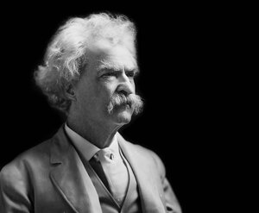
…has been greatly exaggerated
(with apologies to mark twain)

Slide 3
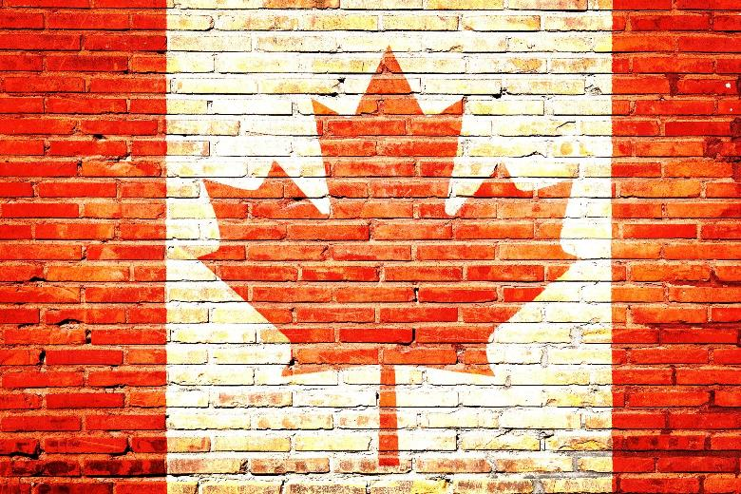
The Canadian Energy Centre
Government of Alberta corporation
CEC Mission: To advance Canada as the supplier of choice for the world’s growing demand of responsibly-produced energy
CEC Research: Tasked to create energy-related fact sheets, research briefs, and other material, and which is relevant to environmental, social, and governance (ESG) issues, for the government, public, media, and investment community. For now, focused on filling gaps in accessible data for public

Slide 4
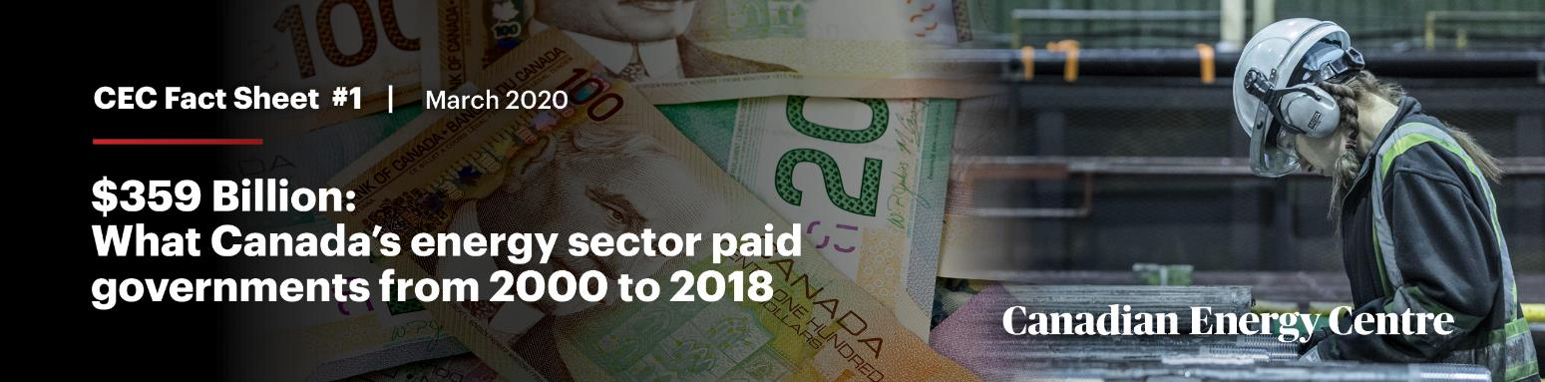
This presentation
Derived from recent Research Briefs and Fact Sheets published by the Canadian Energy Centre
  Why it (Canadian oil and gas) matters
  ‘N.O.U.S.s’
  Exaggerations of mortality?
  Results of (Canadian) self-harm

Slide 5
1. Why it matters
(let me count the ways)
First Nations
Jobs
Tax revenues
Other….

Slide 6
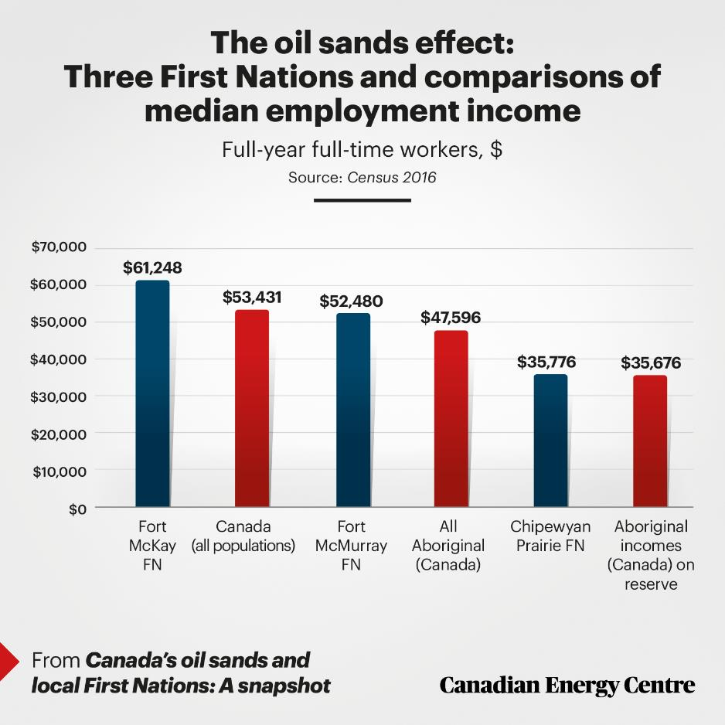
First nations
“Fort McKay is now a thriving modern community with all the amenities and infrastructure in place to run a modern community due to oil sands development.” –Jim Boucher, Former Chief, Fort McKay First Nation

Slide 7
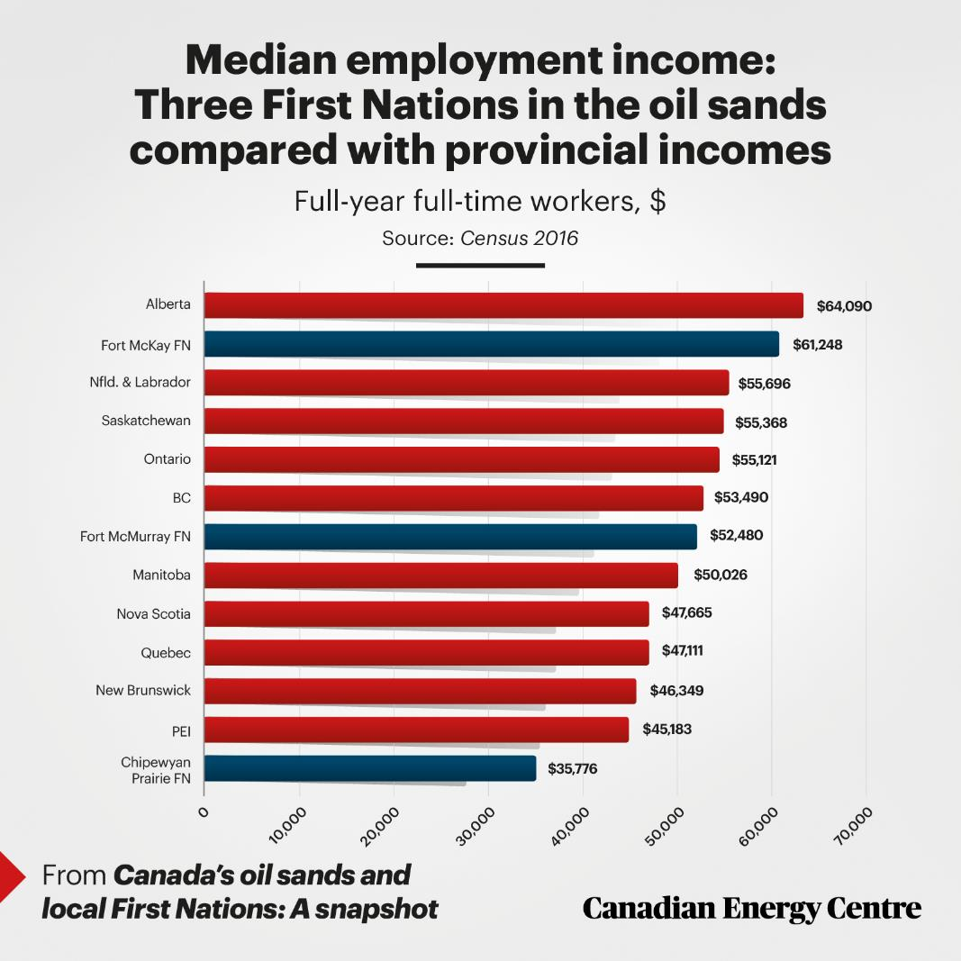

Slide 8
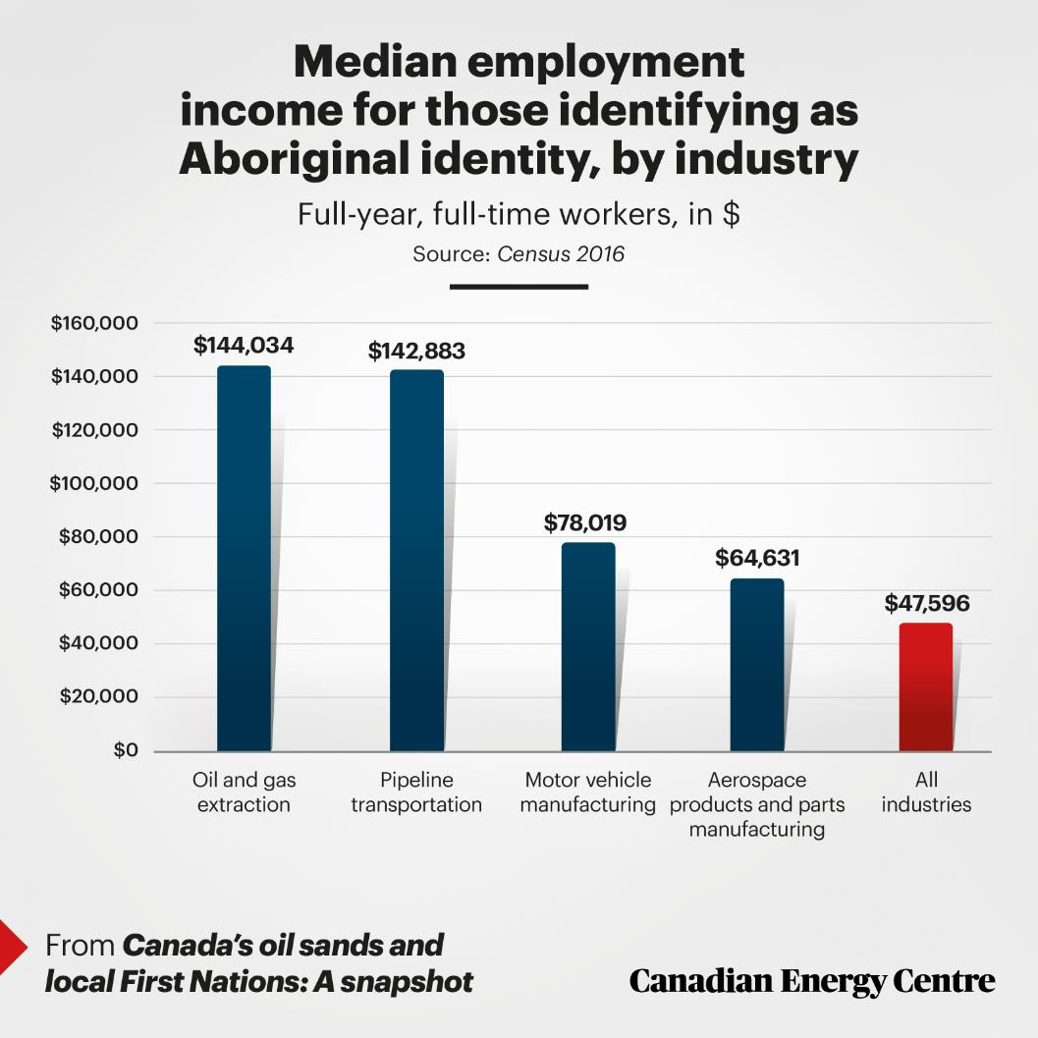

Slide 9
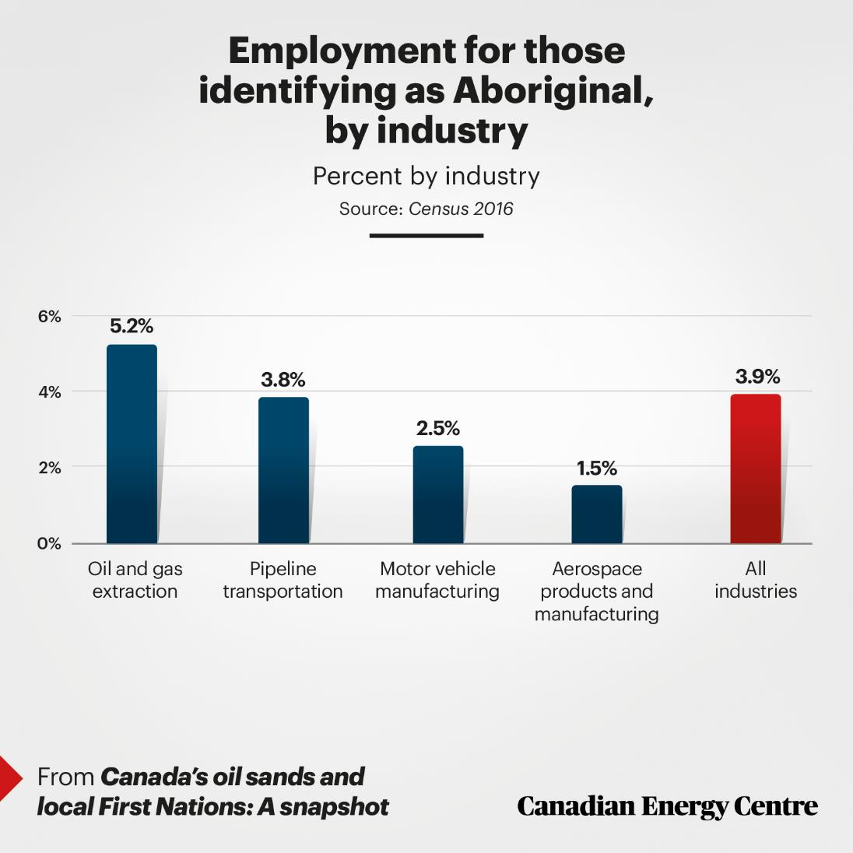

Slide 10
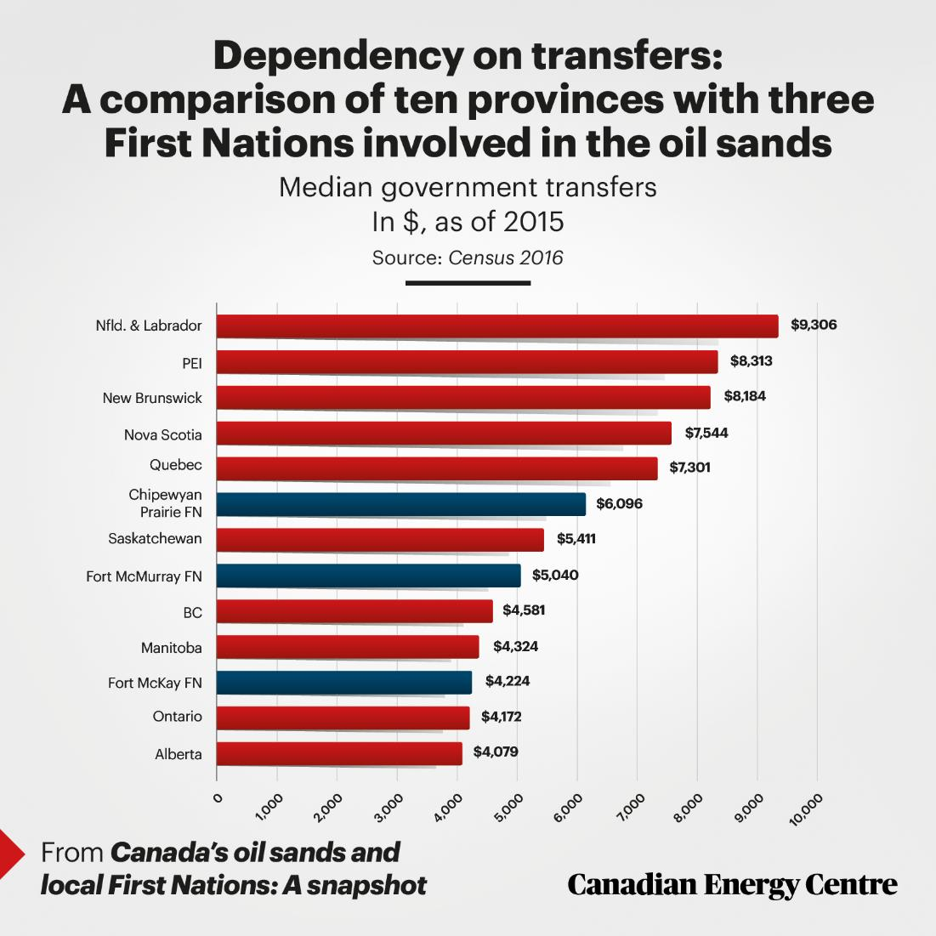

Slide 11

Those are all examples of
2. N.o.U.s.s…

Slide 12
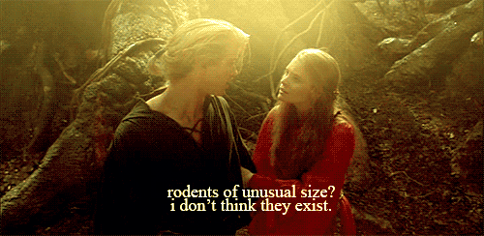
n.o.u.s.s (numbers of unusual sizes)

Slide 13
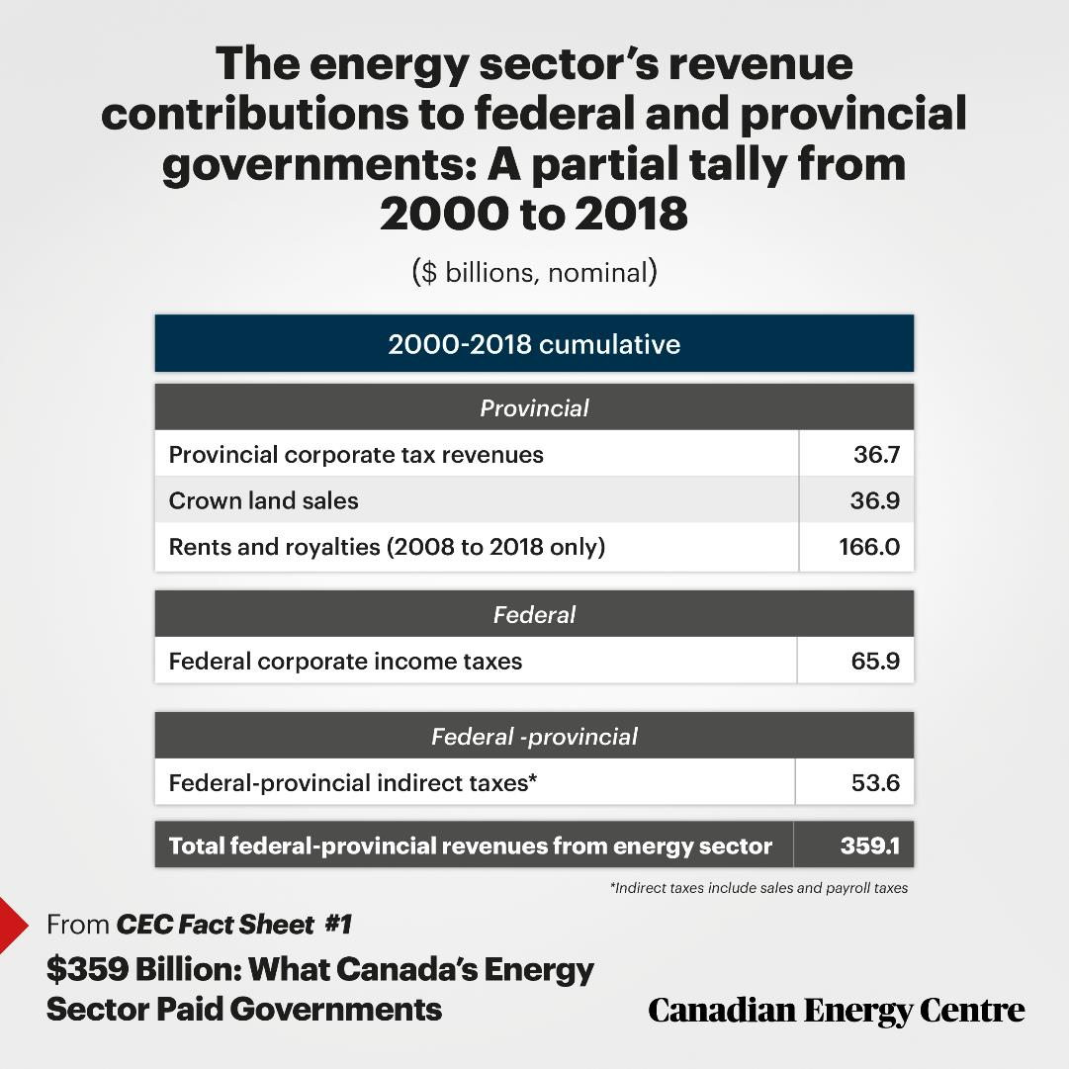
But n.o.u.s.s do exist…

Slide 14
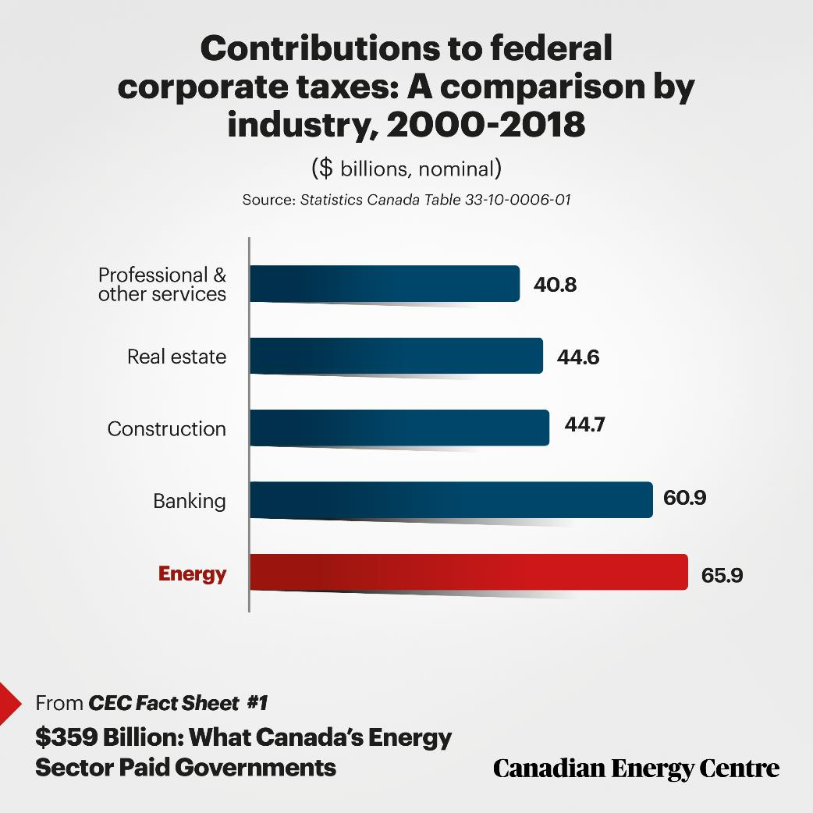
…because of oil and gas in canada

Slide 15
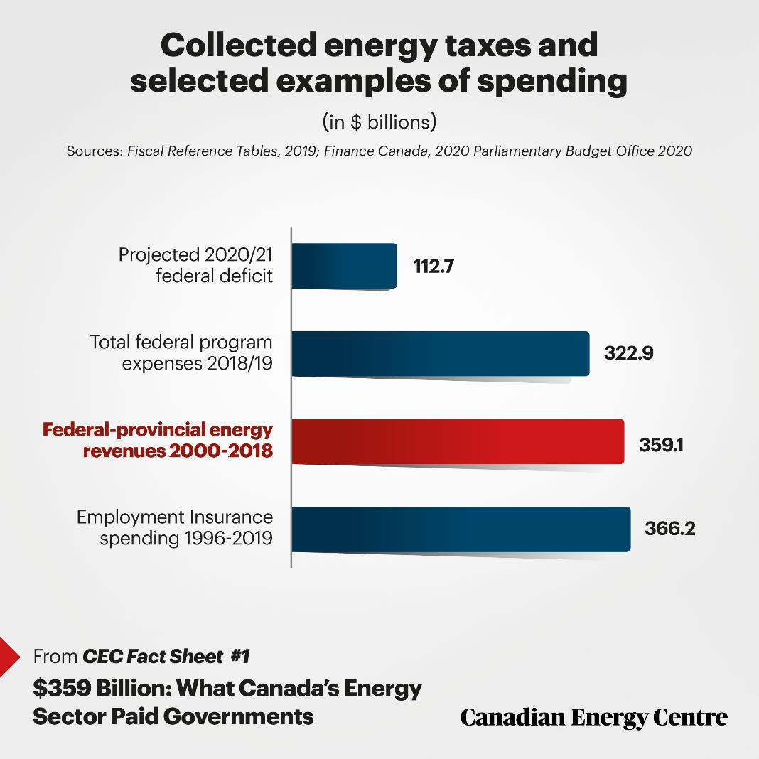
examples of what such tax revenues pay for/are equivalent to:

Slide 16
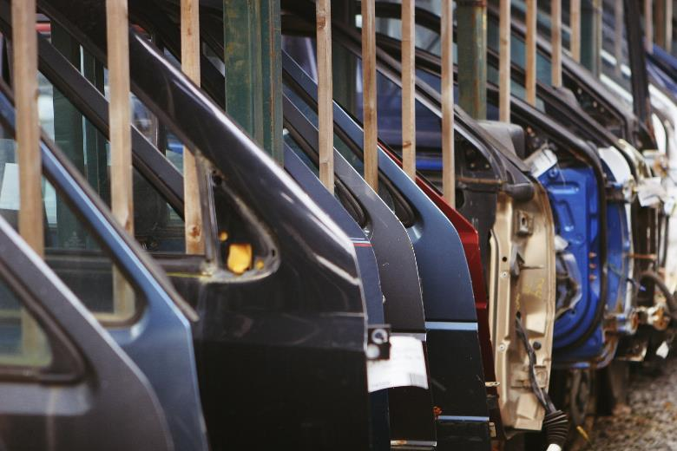
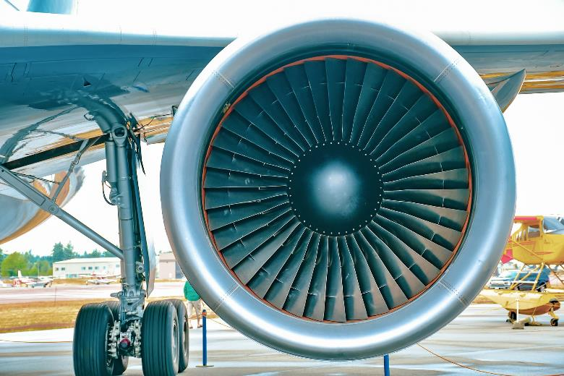
Other big numbers: comparisons

Slide 17
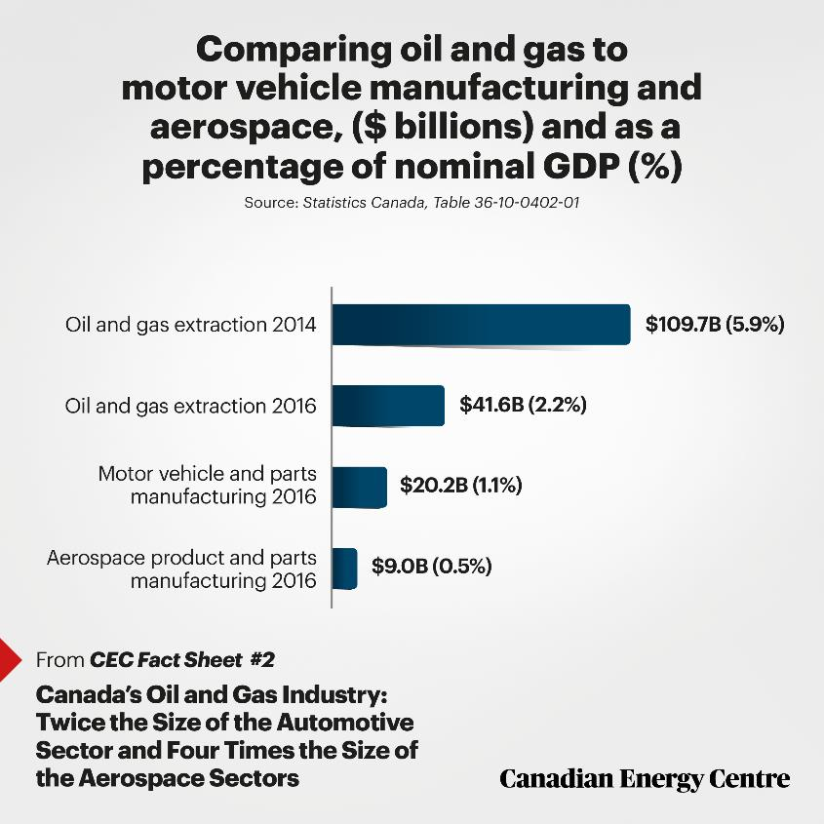
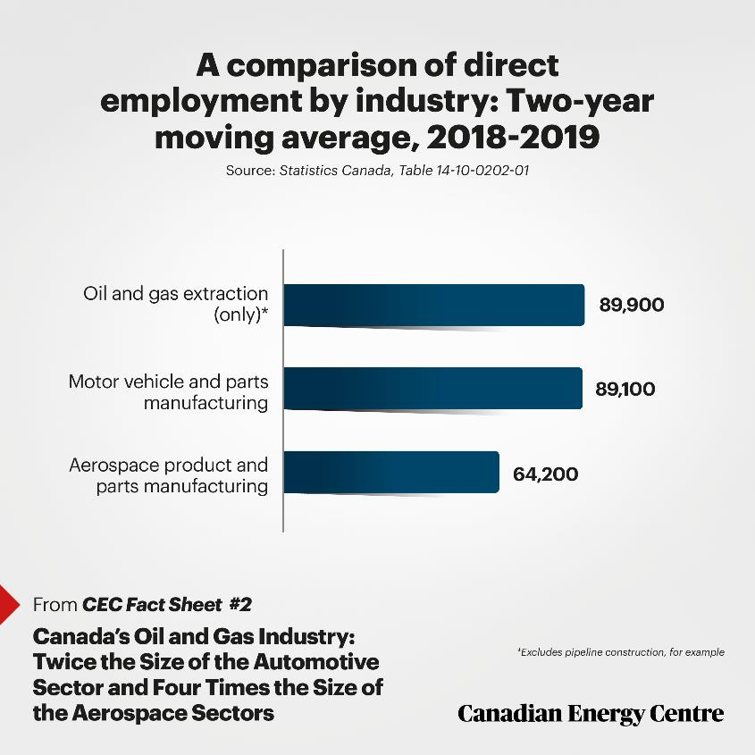

Slide 18
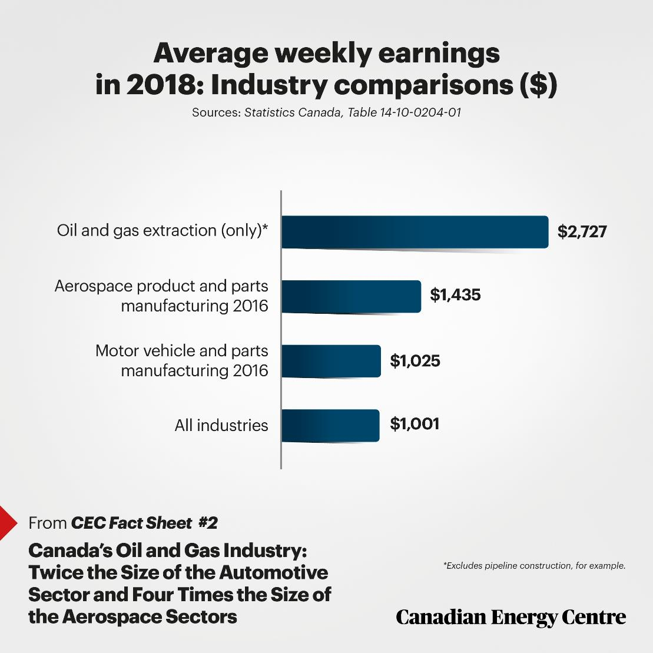

Slide 19
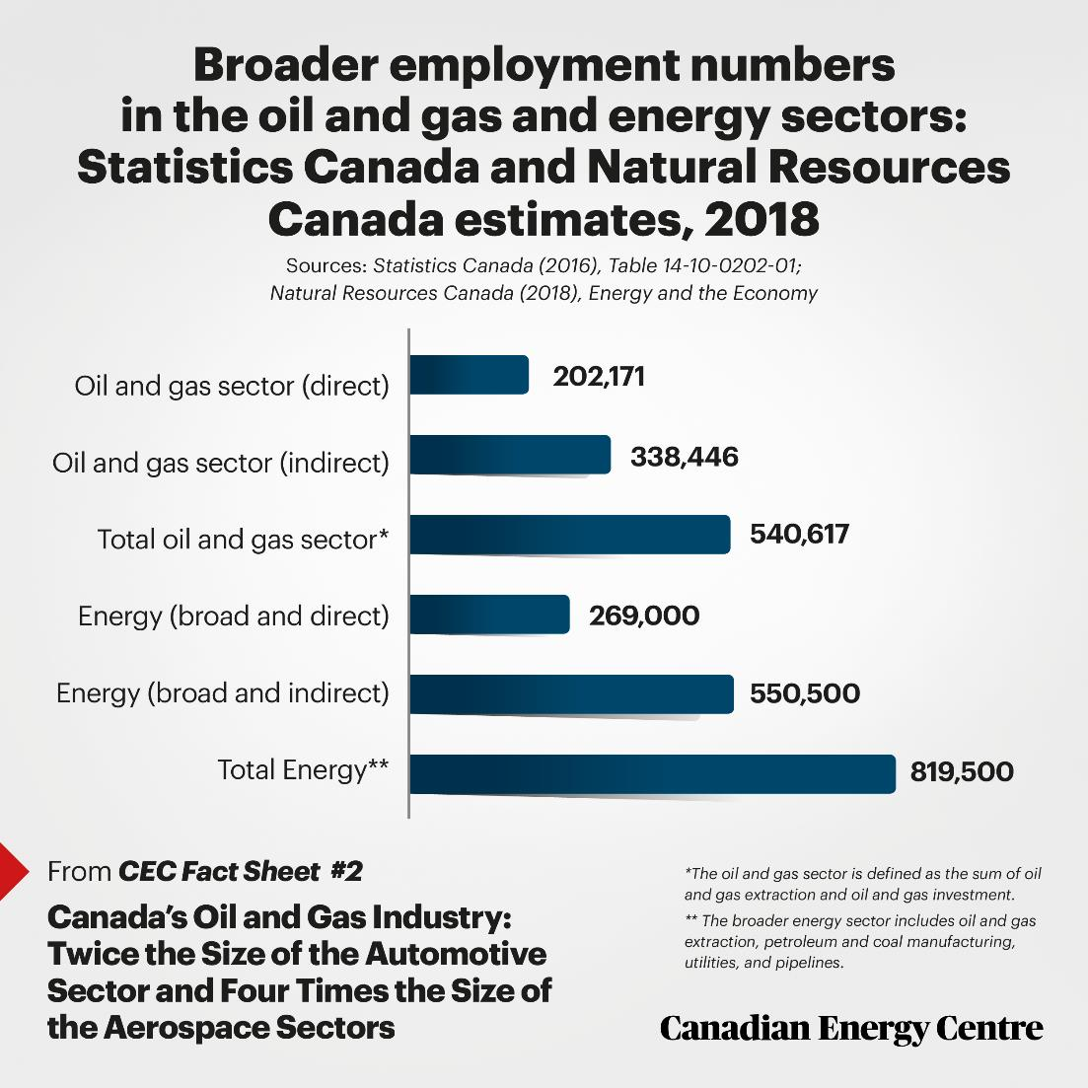

Slide 20
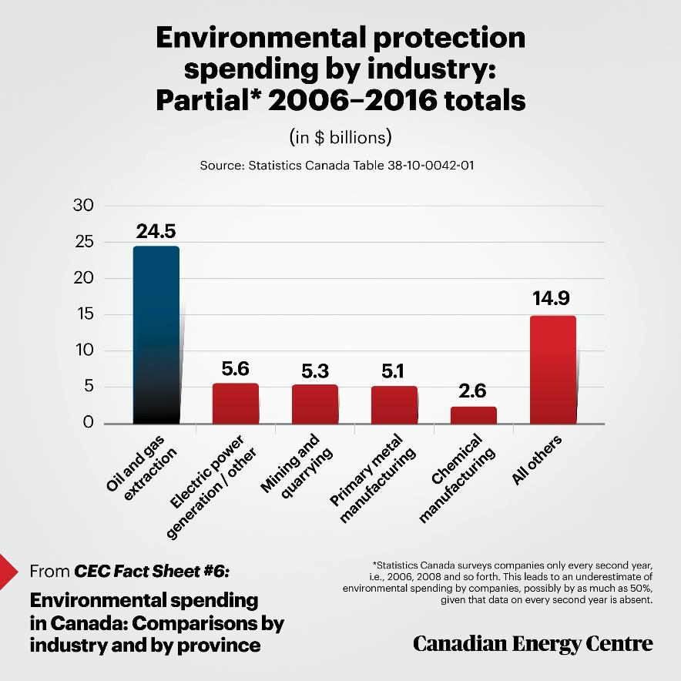
Environment spending: companies

Slide 21
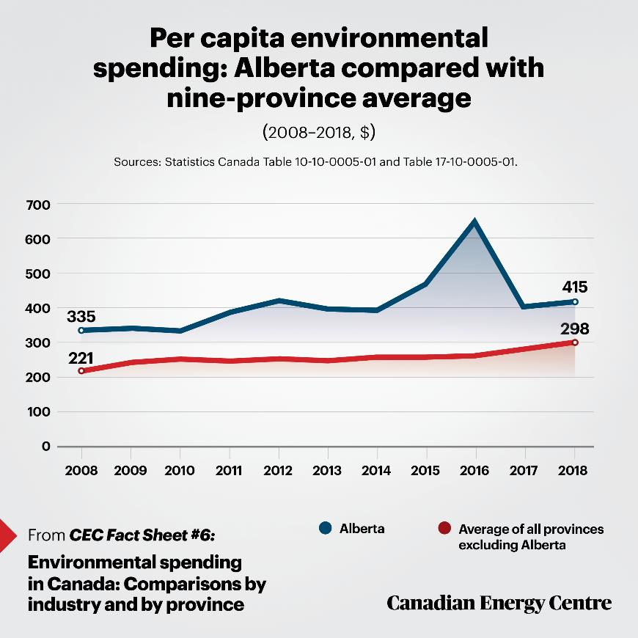
Environment spending: provincial govts.

Slide 22
3. Exaggerations of mortality? Some past trends and present forecasts

Slide 23
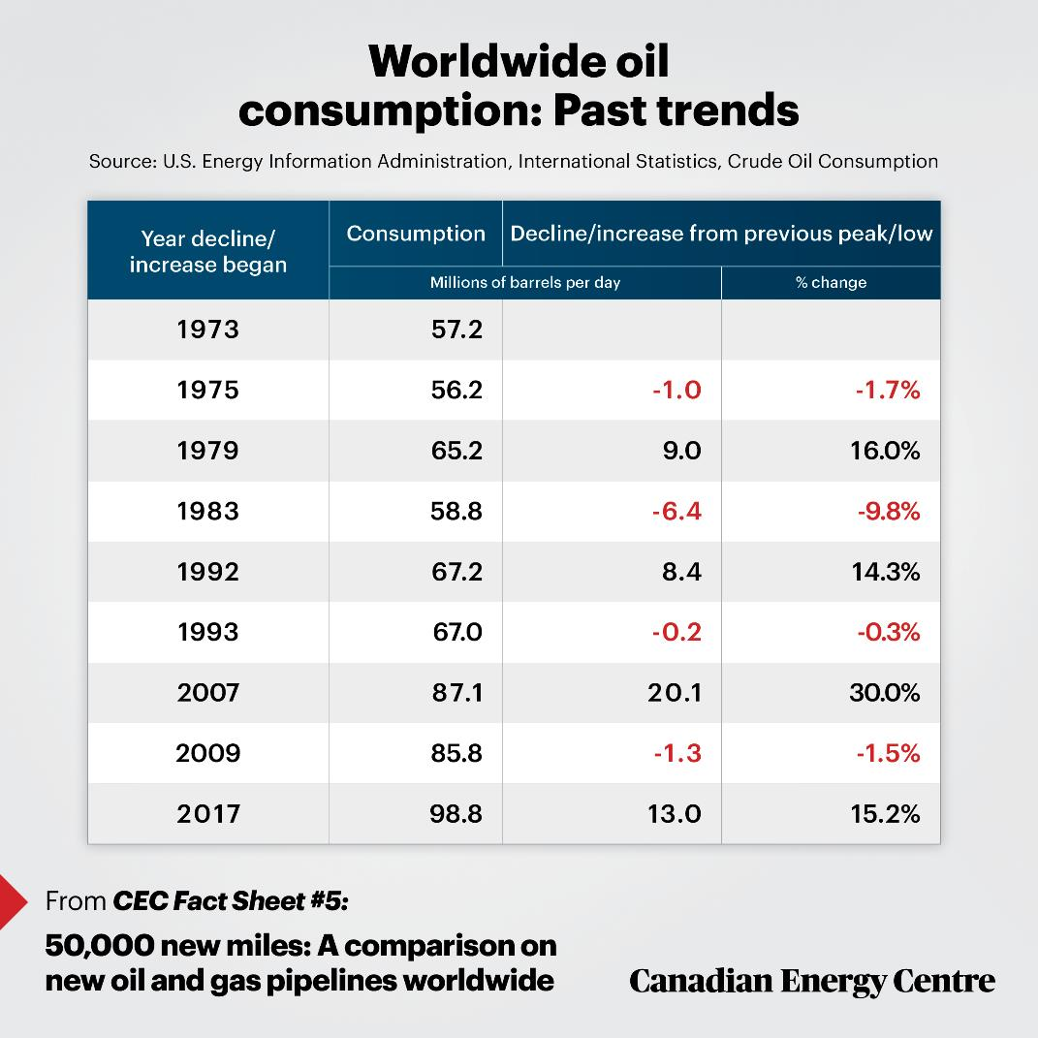

Slide 24
Current forecasts
U.S. Energy Information Administration forecasts that petroleum consumption worldwide will decline by 5.2 million barrels in 2020 from 2019, a 5.2 per cent reduction, before rising again in 2021 by 6.4 million barrels, a 6.7 per cent increase.
The U.S. agency does not provide a natural gas forecast but before the crisis, the International Energy Agency (IEA) forecast a 40 per cent rise in world natural gas consumption by 2050.

Slide 25
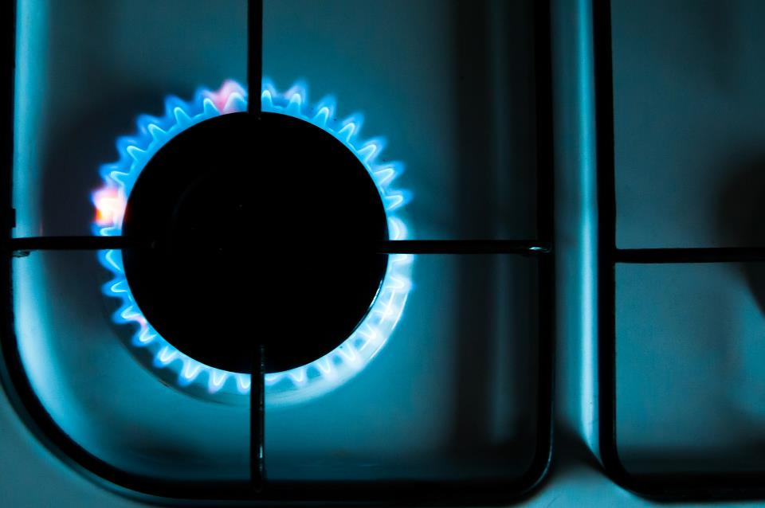
4. The results of (Canadian) self-harm: some examples from history

Slide 26
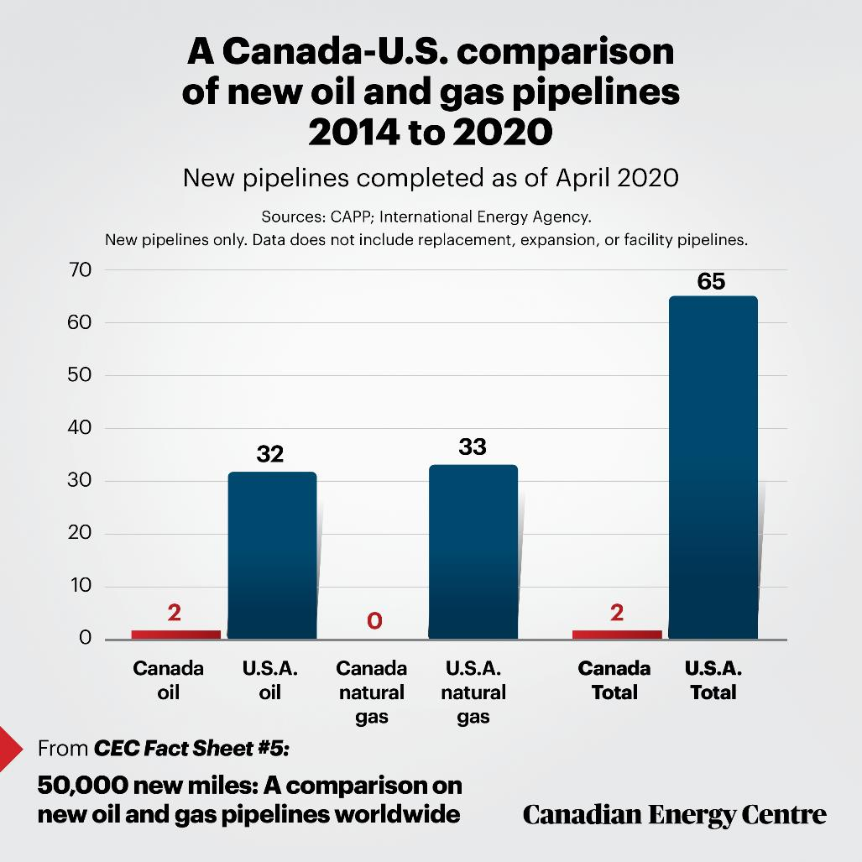

Slide 27
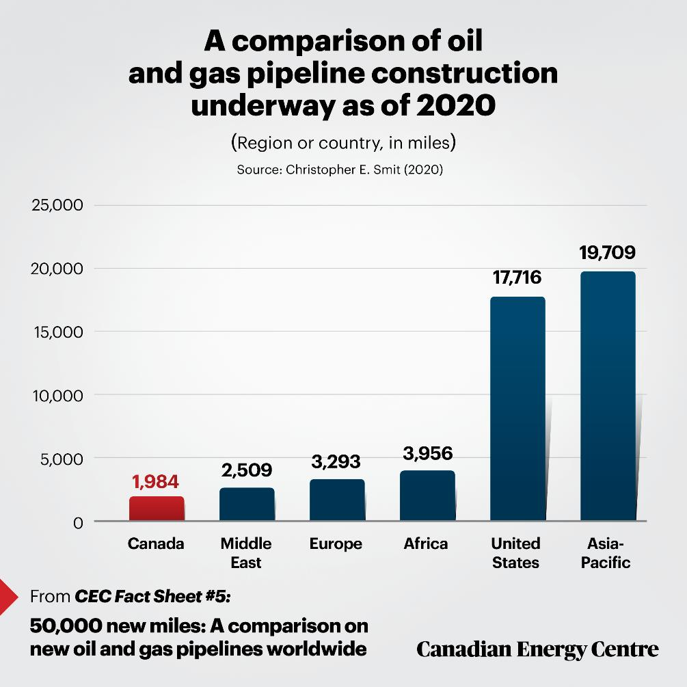

Slide 28
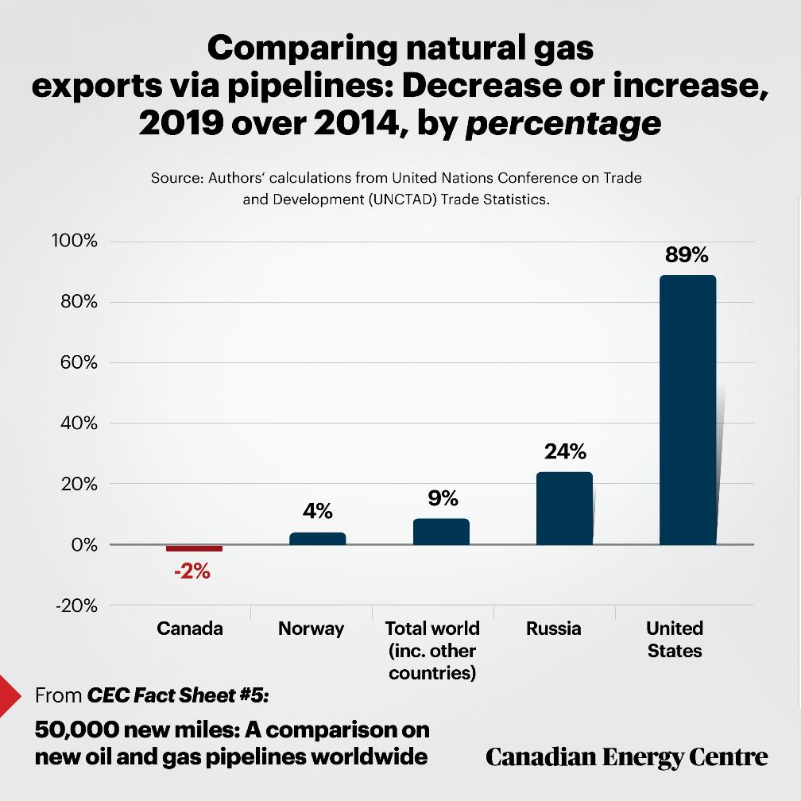

Slide 29
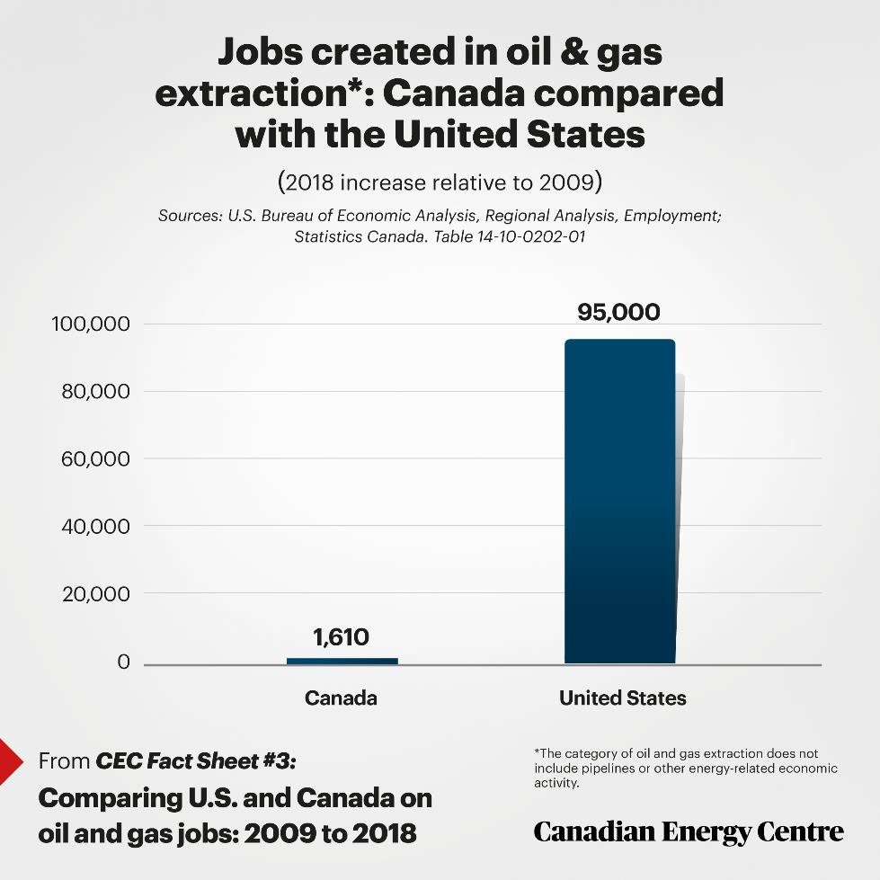

Slide 30
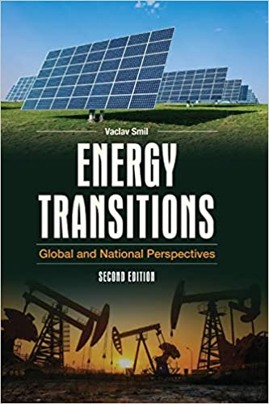

But what about the transition?

Slide 31
“As in the past, the unfolding global energy transitions will last for decades, not years, and modern civilization’s dependence on fossil fuels will not be shed by a sequence of government-dictated goals.”
Prof. Vaclal Smil, Energy Transitions

Slide 32
Fossil fuel divestment has ‘zero’ climate impact, says Bill Gates
Billionaire philanthropist urges investors to back tech that helps cut emissions instead
Financial Times, September 17, 2019

Slide 33
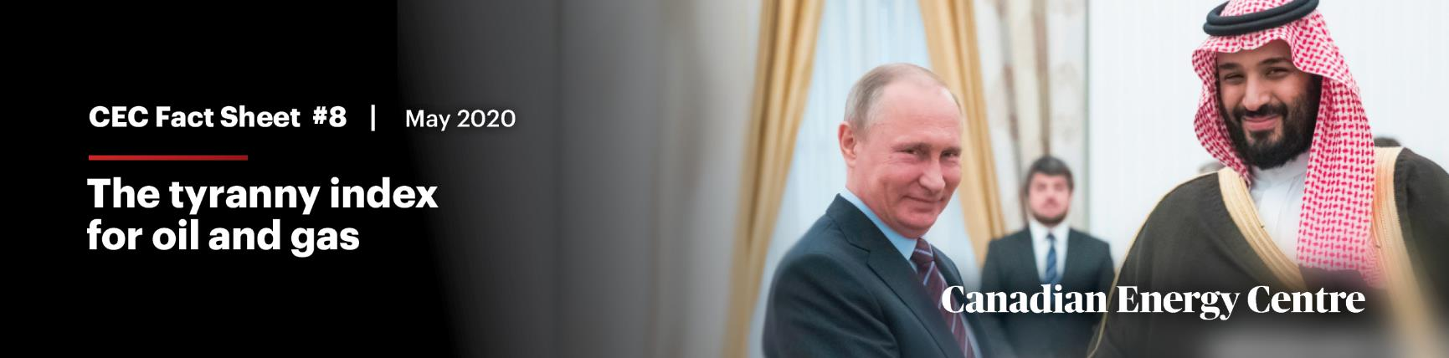
Relevant fact:
The other guys keep producing

Slide 34
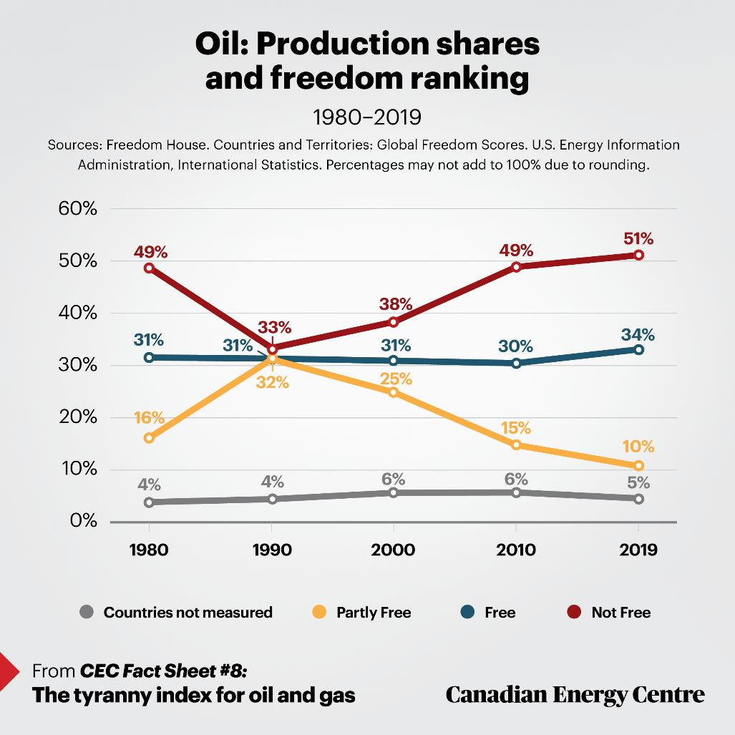

Slide 35
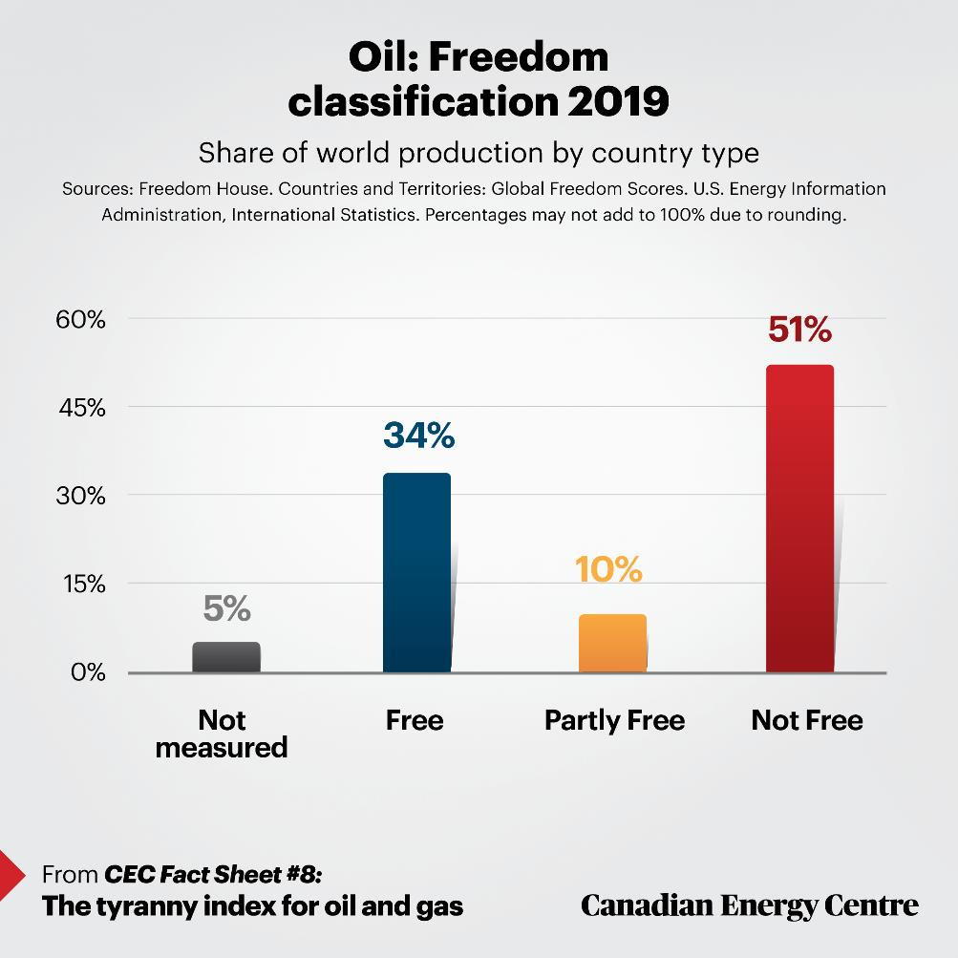

Slide 36
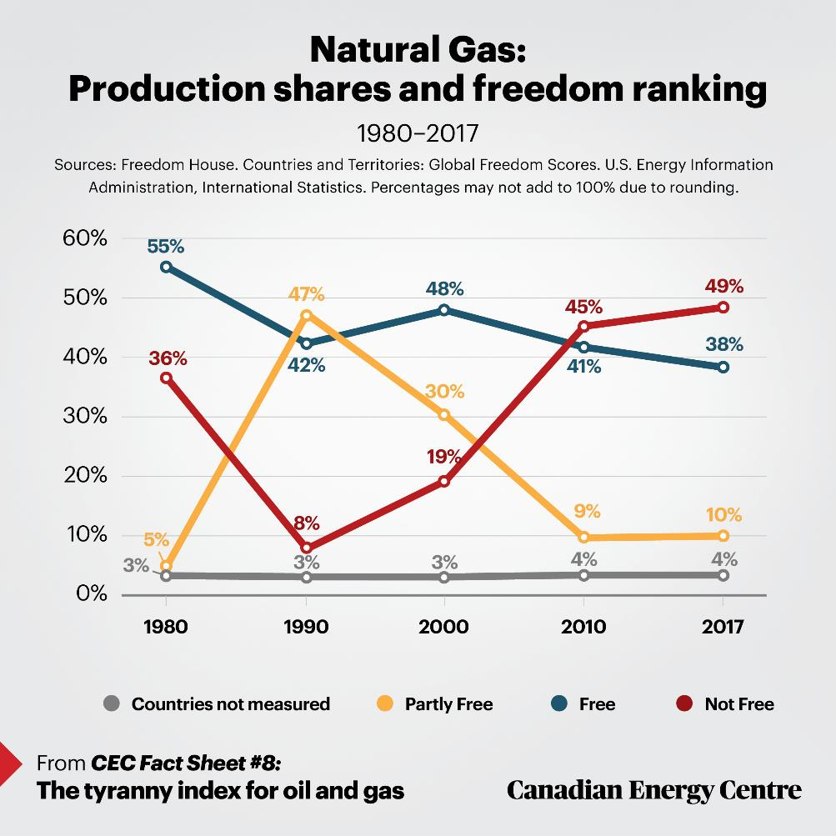

Slide 37
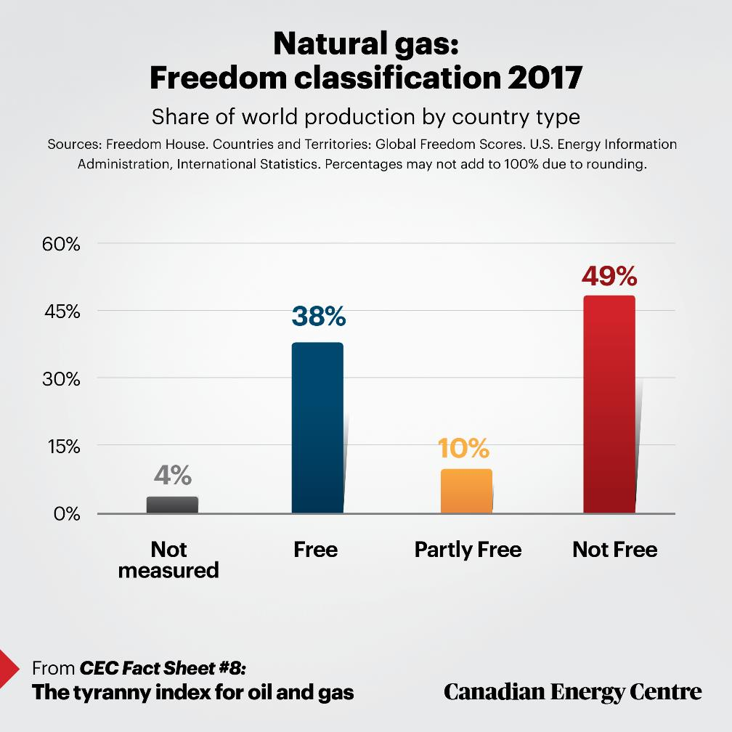

Slide 38
recap
  Why it (Canadian oil and gas) matters:
    First Nations, jobs, tax revenues
  Be it $359 billion in tax revenue or half-a-million high-paying jobs, those are large numbers (‘N.O.U.S.s’)
  Other nations will produce oil and gas if Canada does not. Increasingly, those are in the Not Free category of nation-states
  The temporary Coronavirus demand destruction aside, the death of oil and gas has been exaggerated to date, though Canada does risk making it a self-fulfilling prophecy

Slide 39
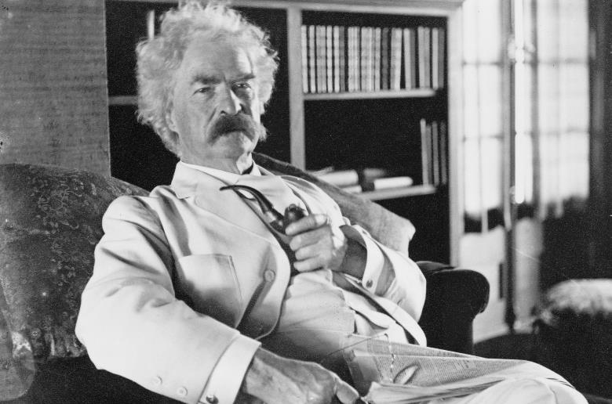
Lessons from history
“I have even heard on good authority that I was dead.”
“The report of my illness grew out of his illness. The report of my death was an exaggeration.”

Slide 40
www.canadianenergycentre.ca
Sources: International Energy Agency; U.S. Energy Information Administration; Statistics Canada; others, please see Fact Sheets at www.canadianenergycentre.ca
Images for this presentation: Pixabay.

